Slide 1
Keras & PyTorch Tutorial For IST700
Jinfen Li
School of Information Studies
Syracuse University
jli284@syr.edu

Slide 2
Introduction of Keras & PyTorch
Keras is an open source neural network library written in Python. It is capable of running on top of TensorFlow. It is designed to enable fast experiments with deep neural networks
PyTorch is an open source machine learning library for Python, based on Torch. It is used for applications such as natural language processing and was developed by Facebook’s AI research group.

Slide 3
Prepare the Data

Slide 4
# Keras from tensorflow.keras.datasets import imdb from tensorflow.keras.preprocessing.sequence import pad_sequences input_dim = 20000 (x_train, y_train), (x_val, y_val) = imdb.load_data(num_words=input_dim) maxlen = 10000 x_train = pad_sequences(x_train, maxlen=maxlen) x_val = pad_sequences(x_val, maxlen=maxlen)
# we need to adapt our data for PyTorch from torch.utils.data import TensorDataset, DataLoader train_data = TensorDataset(torch.from_numpy(x_train), torch.from_numpy(y_train)) valid_data = TensorDataset(torch.from_numpy(x_val), torch.from_numpy(y_val)) train_loader = DataLoader(train_data, shuffle=True, batch_size=batch_size, drop_last=True) valid_loader = DataLoader(valid_data, shuffle=True, batch_size=batch_size, drop_last=True)

Slide 5
Define and Build Models

Slide 6
Keras
In Keras, we can define and build a model at the same time. In the following example, we use the Sequential (https://keras.io/api/models/sequential/) to build a network with several forward layer.
def KerasCustomModel(vocab_size=50): model = Sequential() # Input - Layer model.add(Dense(vocab_size, activation = "relu", input_shape=(10000, ))) # Hidden - Layers model.add(Dropout(0.3, noise_shape=None, seed=None)) model.add(Dense(vocab_size, activation = "relu")) model.add(Dropout(0.2, noise_shape=None, seed=None)) model.add(Dense(vocab_size, activation = "relu")) # Output- Layer model.add(Dense(1, activation = "sigmoid")) model.compile(optimizer="adam",loss="binary_crossentropy",metrics=["accuracy"]) return model

Slide 7
PyTorch
class PytorchCustomModel(nn.Module): def __init__(self, vocab_size=50): super().__init__() self.dense_0 = nn.Linear(10000, vocab_size) self.dropout_0 = nn.Dropout(0.3) … self.activation = nn.Sigmoid() def forward(self, x): output = self.dense_0(x) … output = self.activation(output) return output
The __init__ function instantiates the different modules of the network while the actual computation is decided in the forward function
we define metrics, models and optimizers separately in PyTorch and call them when needed in the training loop
criterion = nn.BCELoss() optimizer = torch.optim.Adam(model.parameters()) model = PytorchCustomModel()

Slide 8
Train & Evaluate Model

Slide 9
# keras model.fit(x=x_train, y=y_train, batch_size=batch_size, epochs=epochs, validation_data=(x_val, y_val))
# step 1: initialize model, optimizer and loss function model = PytorchCustomModel() device = torch.device("cuda" if torch.cuda.is_available() else "cpu") criterion = nn.BCELoss().to(device) optimizer = torch.optim.Adam(model.parameters()) model.to(device)
# step 2: train model from tqdm import tqdm, trange for i in trange(epochs, unit="epoch", desc="Train"): model.train() with tqdm(train_loader, desc="Train") as tbatch: for i, (samples, targets) in enumerate(tbatch): samples = samples.to(device) targets = targets.to(device) model.zero_grad() predictions, _ = model(samples.transpose(0, 1)) loss = criterion(predictions.squeeze(), targets.float()) loss.backward() torch.nn.utils.clip_grad_norm_(model.parameters(), 5) optimizer.step()
# step 3: evaluate model def test(model, val_loader): model.eval() with torch.no_grad(): n_correct = 0 n_samples = 0 with tqdm(val_loader, desc="Valid") as tbatch: for i, (samples, targets) in enumerate(tbatch): samples = samples.to(device) targets = targets.to(device) predictions, _ = model(samples.transpose(0, 1)) acc = (predictions.round().squeeze() == targets).sum().item() acc = acc / batch_size test(model, val_loader)

Slide 10
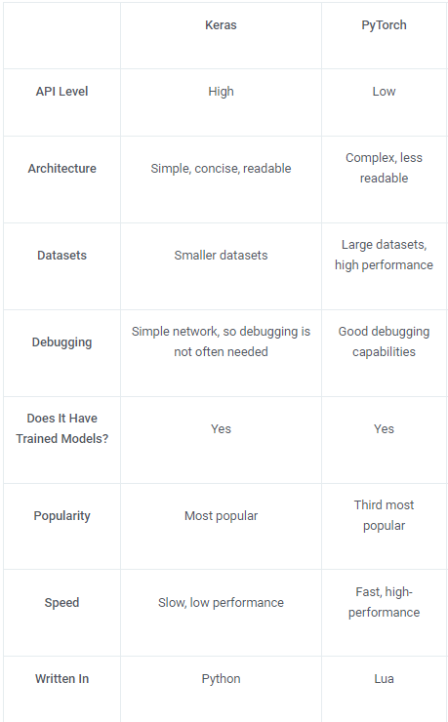
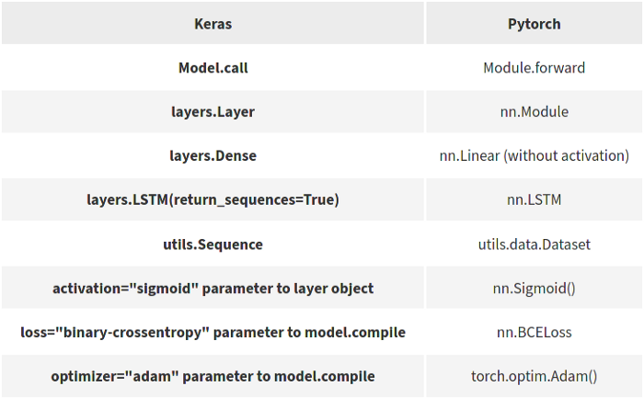
Comparison

Slide 11
Resources
https://towardsdatascience.com/comparing-keras-and-pytorch-syntaxes-54b164268466
https://www.simplilearn.com/keras-vs-tensorflow-vs-pytorch-article

